Slide 1



User Interface
- Raeha Sandalwala

Slide 2
Contents
Introduction to UI
Layouts
UI Controls
Menus and ‘Toasts’
Notifications
Other interesting UIs
  ListView
  Dialogs
  DatePicker
  Sliding Drawer

Slide 3
Introduction to User Interface (UI)
The user interface of an application is everything that the user can see and interact with.
Android provides a variety of pre-built UI components such as structured layout objects and UI controls.
E.g. : dialogs, notifications, and menus.

Slide 4
Two UI Approaches
Procedural
Declarative
Write Java code.
Write XML code
Similar to HTML of a webpage.
Two styles can be mixed :
Start with XML and declare most of UI.
Switch to Java and implement UI logic.

Slide 5
Android Layouts

Slide 6
What is a Layout?
A Layout defines the visual structure for a user interface, i.e. it handles the arrangement of components on the screen. Layouts can be declared in two ways:
Declare UI elements in XML: Android provides a straightforward method of declaring layouts in XML file.
Instantiate layout elements at runtime: An application can declare layouts (and manipulate their properties) programmatically.

Slide 7

Horizontal
Linear Layout
Table Layout
Grid Layout
Relative Layout
Vertical

Slide 8
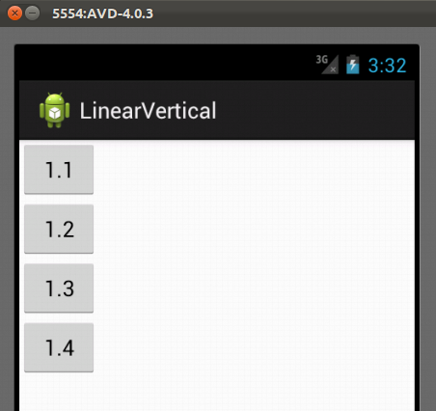

Slide 9
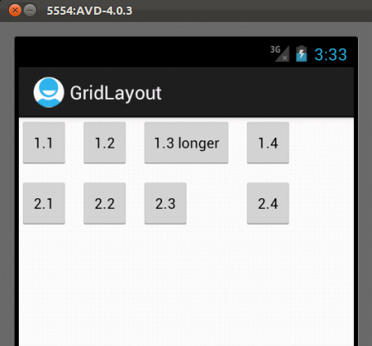

Slide 10
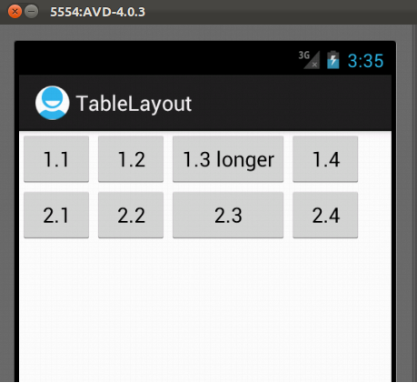

Slide 11
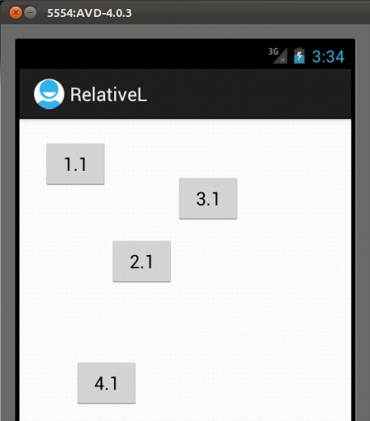

Slide 12
Android UI Controls

Slide 13
UI Controls
Some of the basic UI controls are :
TextView
EditText
Button
Radio Button
Checkbox
Spinner

Slide 14
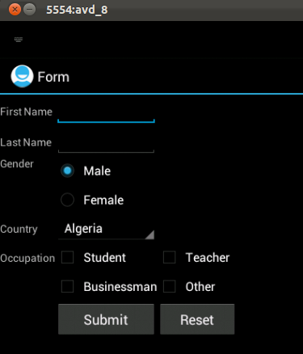

Slide 15
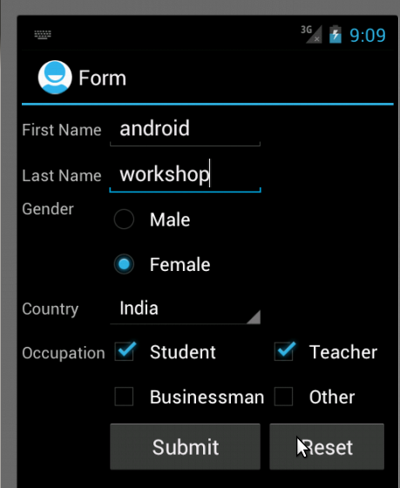

Slide 16
Android Menu and ‘Toast’

Slide 17

A Menu is a common user interface component in many types of applications.
Types of Menu
Options menu : The options menu is the primary collection of menu items for an activity.
E.g. : ‘Search’, ‘Compose email’, and ‘Settings’.

Slide 18
Types of Menu…(2)
Popup menu : A popup menu displays a list of items in a vertical list that is anchored to the view that invoked the menu.
Toast : A toast provides simple feedback about an operation, in a small popup.

Slide 19
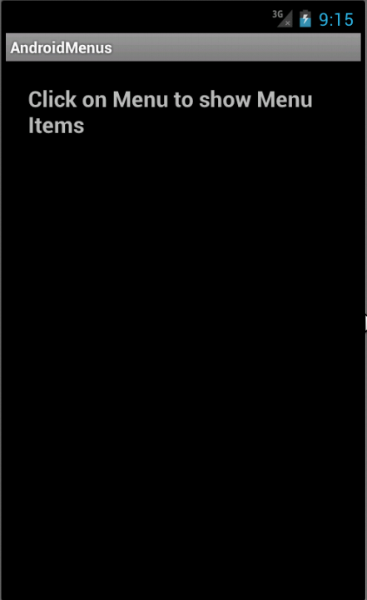

Slide 20
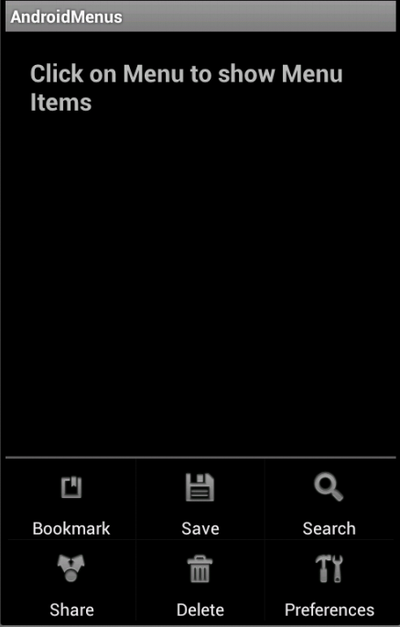

Slide 21
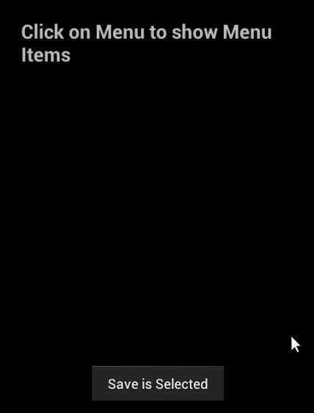

Slide 22
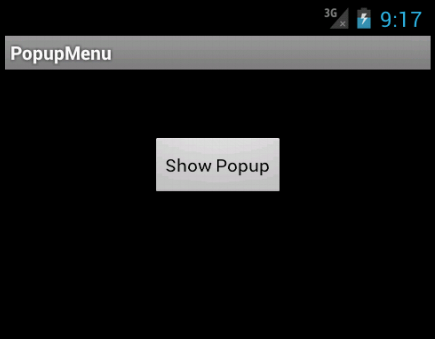

Slide 23
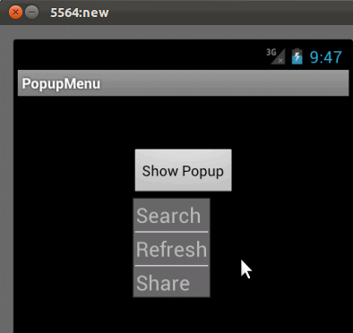

Slide 24
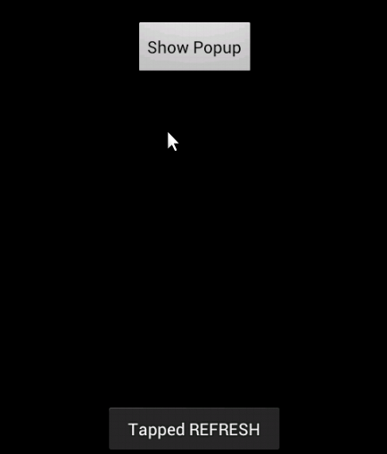

Slide 25
Android Notifications

Slide 26

A notification is a message that can be displayed to the user, outside of the user interface of an application.
To see the details of the notification, the user opens the notification drawer.
Both the notification area and the notification drawer, are system-controlled areas that the user can view at any time.

Slide 27
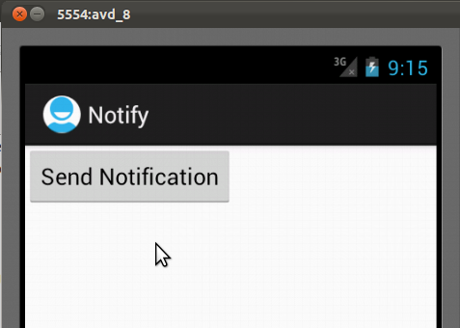

Slide 28
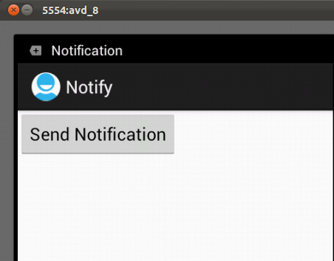

Slide 29
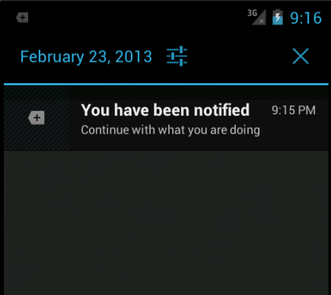

Slide 30
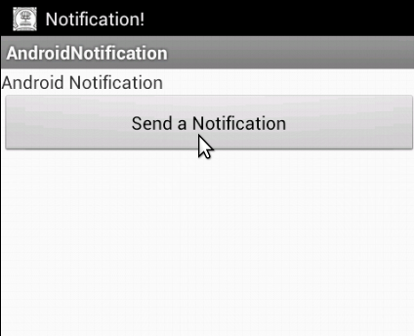

Slide 31
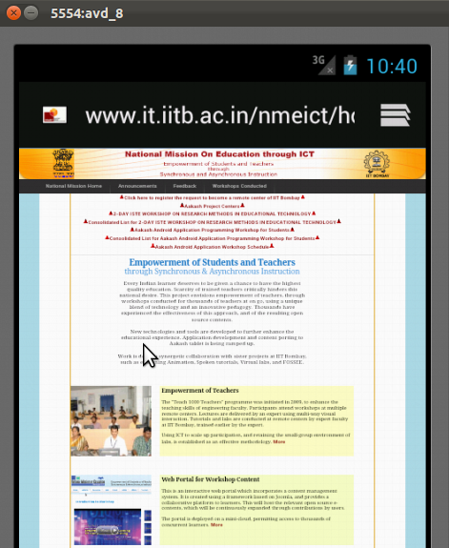

Slide 32
List View

Slide 33

ListView is a view-group that displays a list of scrollable items.
The items in the list are automatically inserted into the list using an Adapter.
The Adapter pulls content from a source such as an array or database query, and converts each item selection result into a view that is placed into the list.

Slide 34
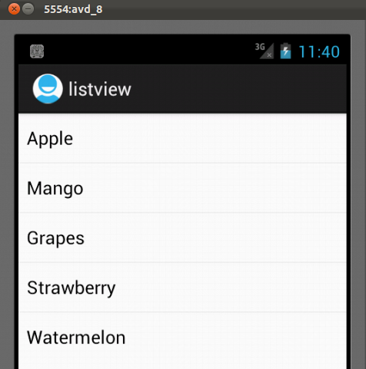

Slide 35
Dialogs in Android

Slide 36

A dialog is a small window, that prompts the user to make a decision or enter additional information.
A dialog does not fill the screen, and is normally used for model events that require users to take an action before they can proceed.

Slide 37
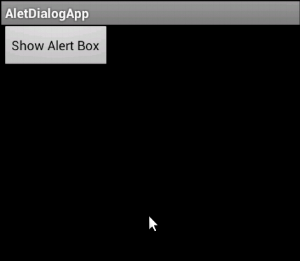

Slide 38
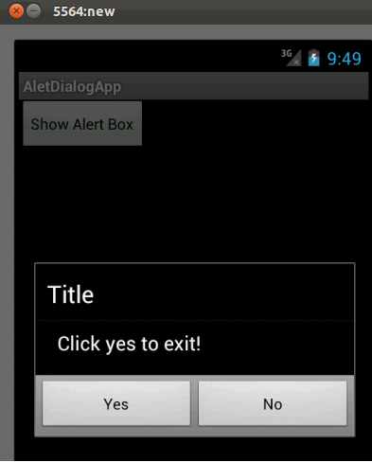

Slide 39
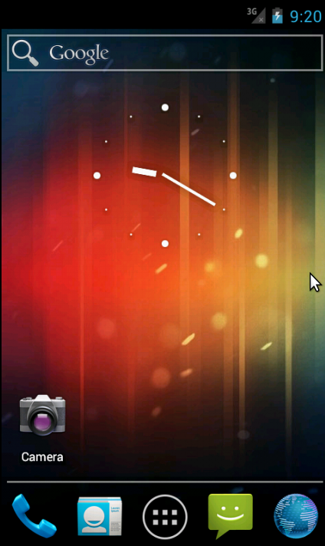

Slide 40
DatePicker in Android

Slide 41
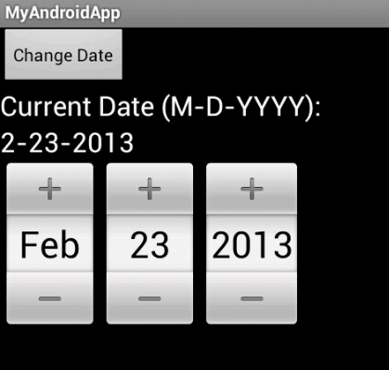

Slide 42
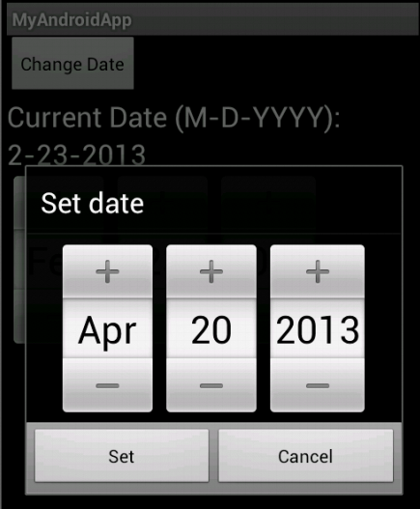

Slide 43
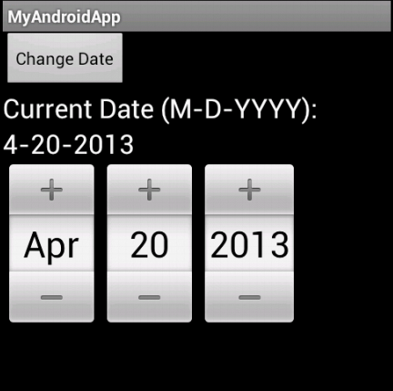

Slide 44
Sliding Drawer

Slide 45
Sliding Drawer
SlidingDrawer hides content out of the screen and allows the user to drag a handle to bring the content on screen.
It is composed of two children views: the handle, that the users drags, and the content, attached to the handle and dragged with it.
It is used as an overlay inside layouts.

Slide 46
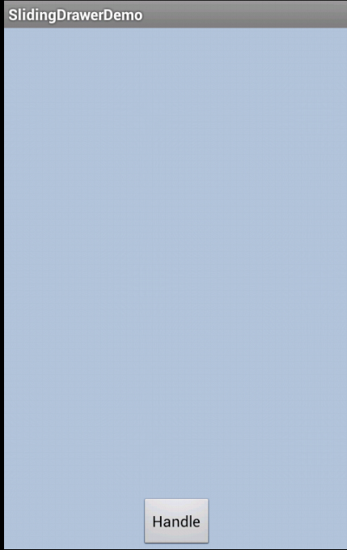

Slide 47
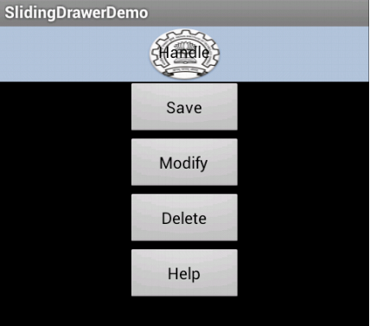

Slide 48
Summary

Slide 49
Summary
Everything that the user sees and interacts with on the screen is User Interface.
Four types of Layouts.
UI controls are the interactive components of an application.
Menus and ‘Toasts’ are some of the pre-defined components in Android.

Slide 50
Summary…(2)
Notification allows user to display a message out of the normal UI of an application.
ListView is a list of scrollable items.
Dialog box asks a user to make a decision.
DatePicker is used to insert date.
Sliding Drawer acts as an overlay.

Slide 51
References
http://developer.android.com/
http://www.vogella.com/
http://www.mkyong.com/
http://thenewboston.org/
http://www.lynda.com

